Slide 1
R Workshop – Sarah Gets a Diamond
April 11, 2018
Sponsors: Data Science Club & Technology Club
Presenter: Dang Trinh

Slide 2
Table of Contents
Overview of data science
Data science toolkit
Sarah gets a diamond – let’s dig into the data
Sneak peak on the Data Science course next year
Data science, machine learning, and subconscious bias

Slide 3
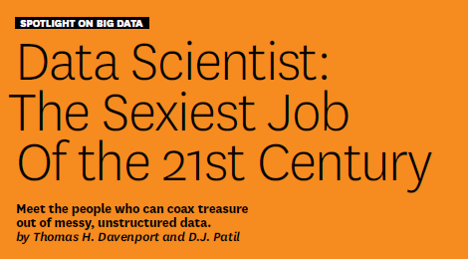
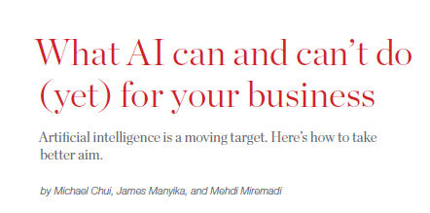
Data science? Machine learning? Artificial intelligence?
33_84

Slide 4
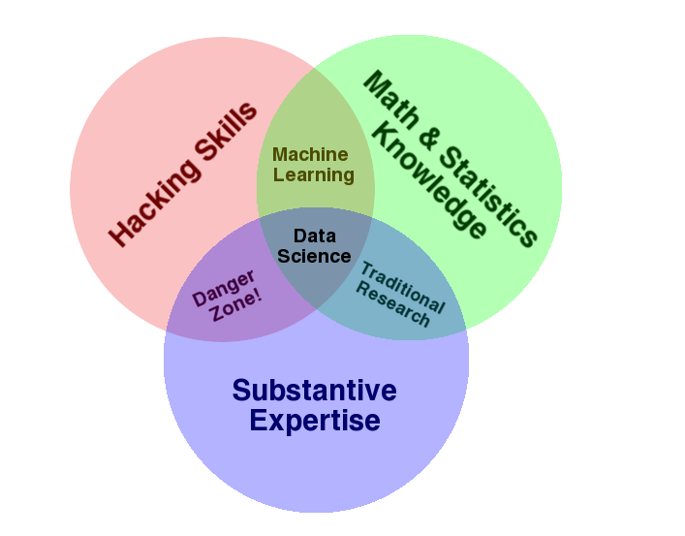
The data science Venn diagram – Drew Conway
33_84

Slide 5
Table of Contents
Overview of data science
Data science toolkit
Sarah gets a diamond – let’s dig into the data
Sneak peak on the Data Science course next year
Data science, machine learning, and subconscious bias

Slide 6

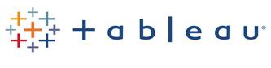






Reproducibility & self-containment
33_84

Slide 7
Table of Contents
Overview of data science
Data science toolkit
Sarah gets a diamond – let’s dig into the data
Sneak peak on the Data Science course next year
Data science, machine learning, and subconscious bias

Slide 8
Table of Contents
Overview of data science
Data science toolkit
Sarah gets a diamond – let’s dig into the data
Data exploration & visualization
Feature engineering
Initial regression
Other algorithms
Sneak peak on the Data Science course next year
Data science, machine learning, and subconscious bias

Slide 9
Table of Contents
Overview of data science
Data science toolkit
Sarah gets a diamond – let’s dig into the data
Data exploration & visualization
Feature engineering
Initial regression
Other algorithms
Sneak peak on the Data Science course next year
Data science, machine learning, and subconscious bias

Slide 10
Table of Contents
Overview of data science
Data science toolkit
Sarah gets a diamond – let’s dig into the data
Data exploration & visualization
Feature engineering
Initial regression
Other algorithms
Sneak peak on the Data Science course next year
Data science, machine learning, and subconscious bias

Slide 11
Table of Contents
Overview of data science
Data science toolkit
Sarah gets a diamond – let’s dig into the data
Data exploration & visualization
Feature engineering
Initial regression
Other algorithms
Sneak peak on the Data Science course next year
Data science, machine learning, and subconscious bias

Slide 12
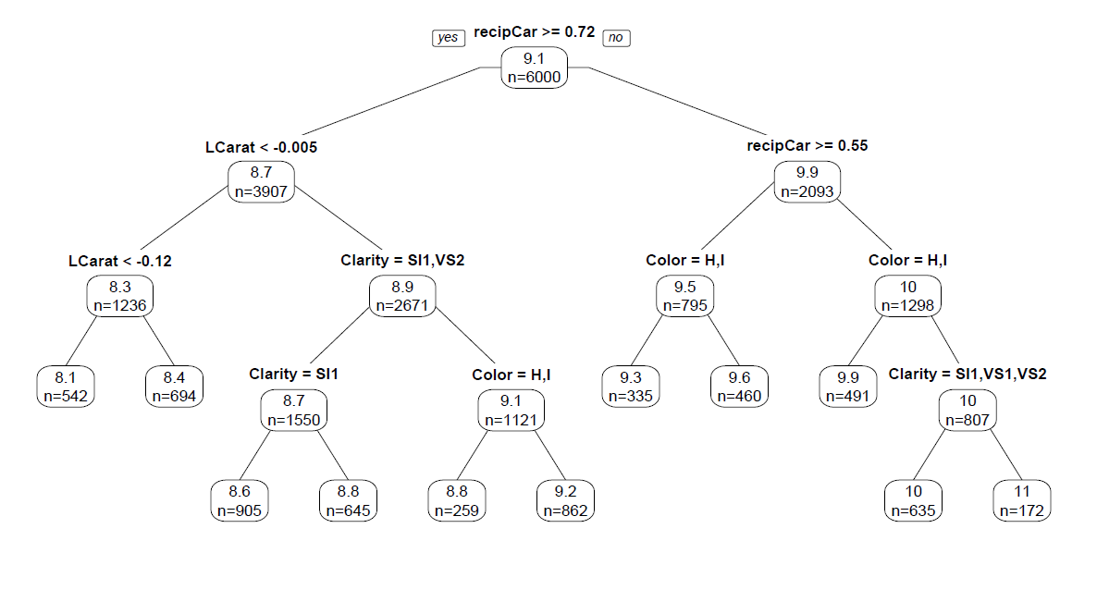
Regression trees/classification trees
33_84

Slide 13
Ensembles
33_84

Slide 14
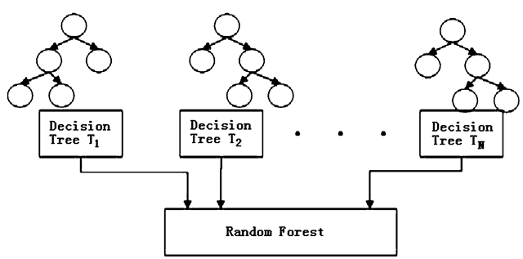
Bagged Trees & Random Forest
33_84

Slide 15
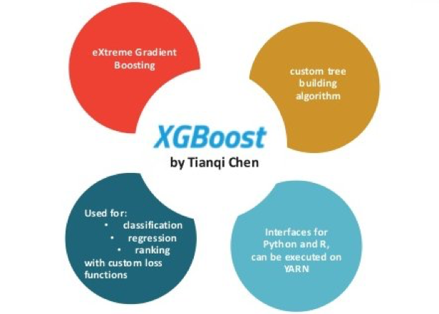
Boosted Trees
33_84

Slide 16
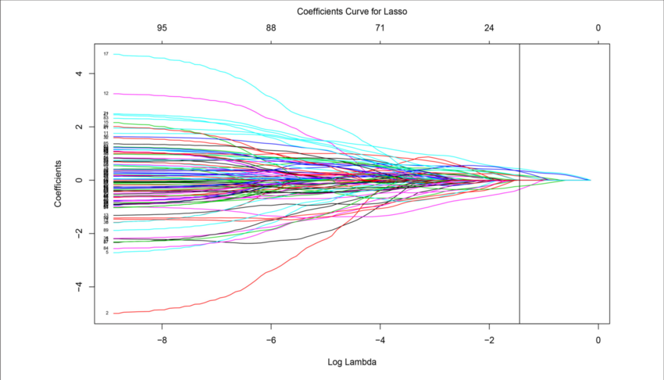
LASSO (least absolute shrinkage and selection operator)
33_84

Slide 17
Table of Contents
Overview of data science
Data science toolkit
Sarah gets a diamond – let’s dig into the data
Data exploration & visualization
Feature engineering
Initial regression
Other algorithms
Sneak peak on the Data Science course next year
Data science, machine learning, and subconscious bias

Slide 18
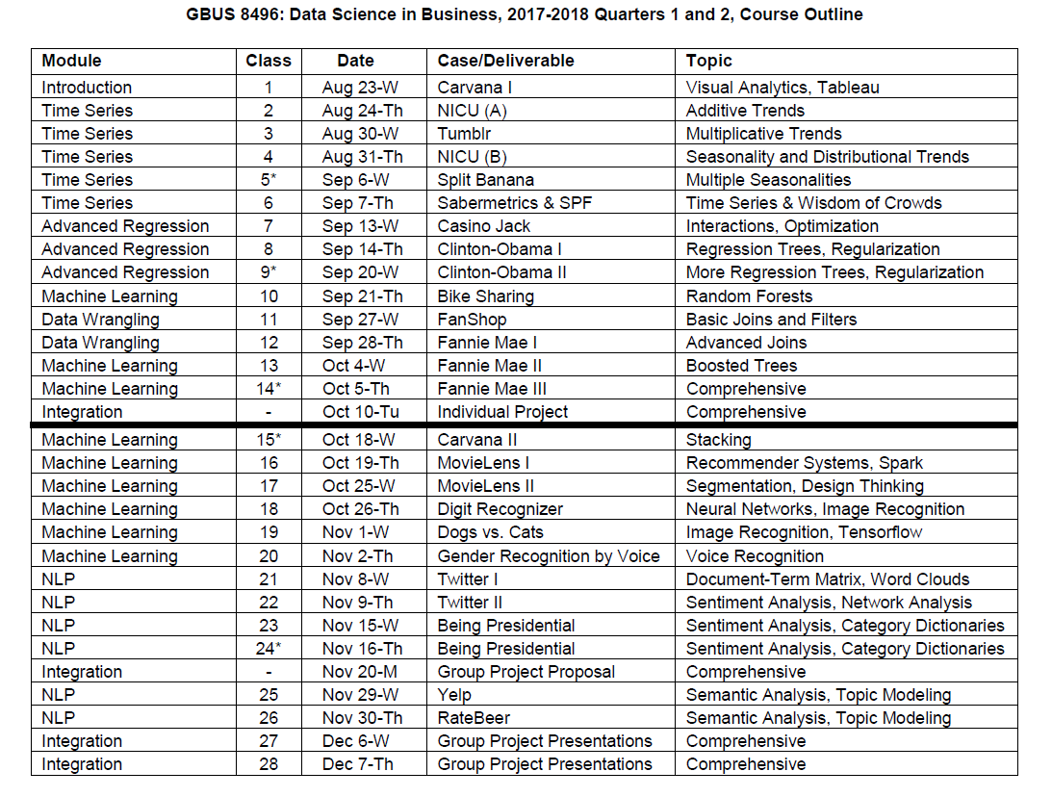
Highly recommended – extensive materials
33_84

Slide 19
Table of Contents
Overview of data science
Data science toolkit
Sarah gets a diamond – let’s dig into the data
Data exploration & visualization
Feature engineering
Initial regression
Other algorithms
Sneak peak on the Data Science course next year
Data science, machine learning, and subconscious bias

Slide 20
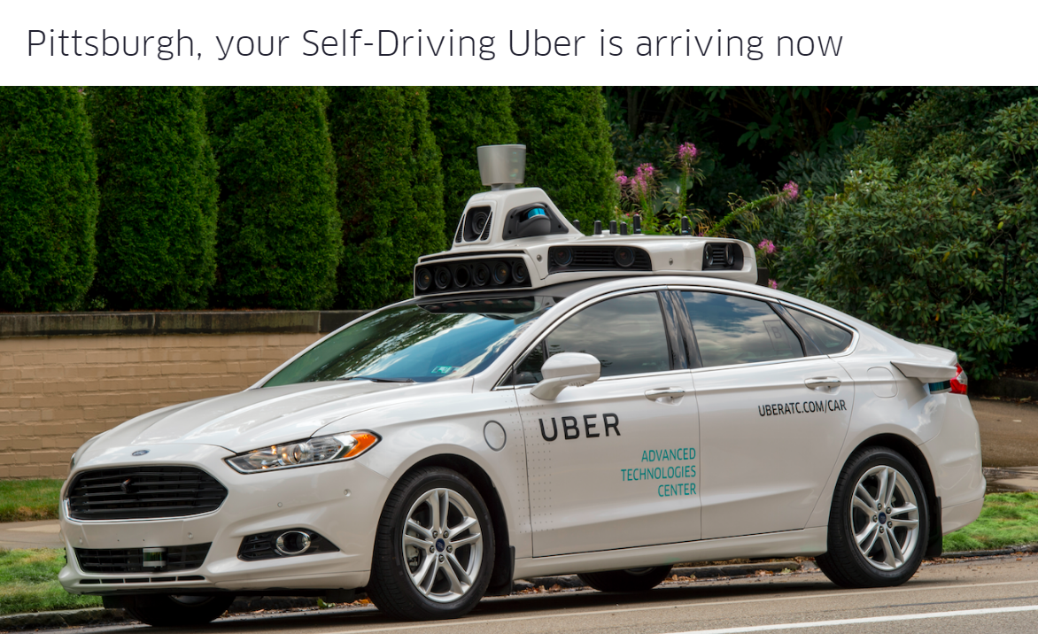
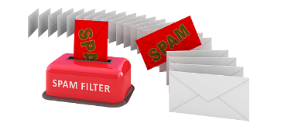



AI Undoubtedly Revolutionized Our Lives & Remains at the Forefront of Our Future
33_84
Though most people do not realize it, our daily lives are inundated with products made possible only through artificial intelligence

Slide 21
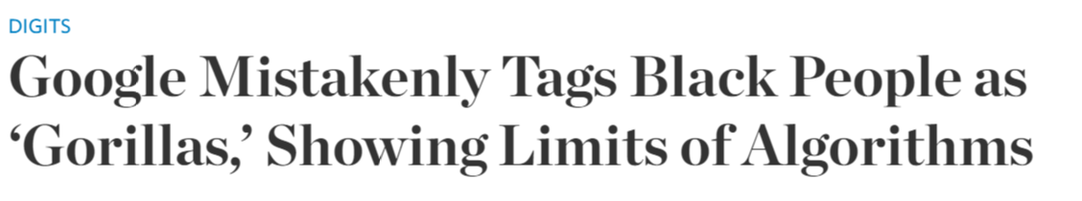
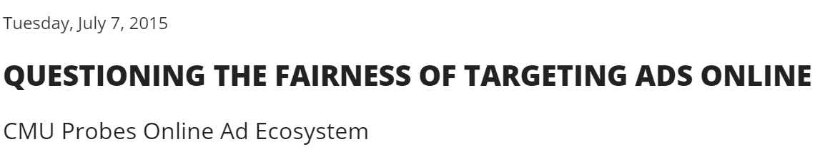
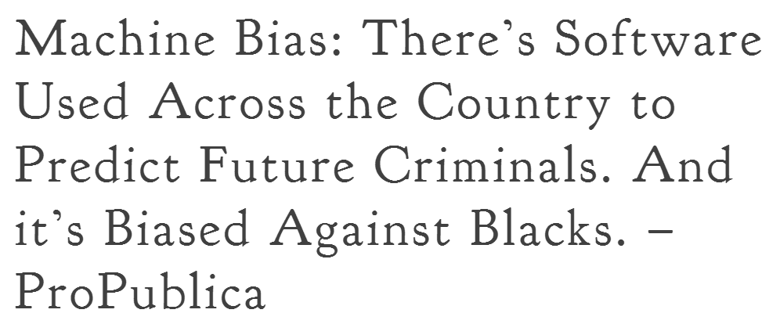
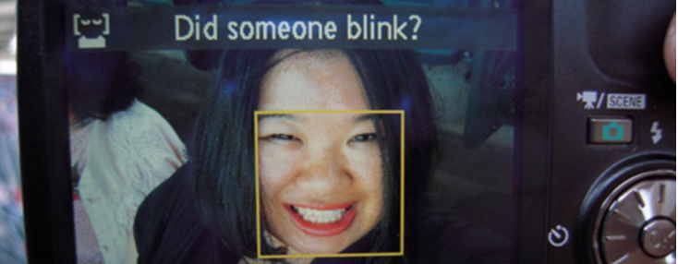
Yet Subconscious Bias Managed to Bury Its Claws into this Future’s Frontier
33_84
“Histories of discrimination can live on in digital platforms, and if they go unquestioned, they become part of the logic of everyday algorithmic systems”

Slide 22
With Great Power Comes Great Responsibility Kate Crawford, “AI’s White Guy Problem,” NY Times
33_84
Just like any tool created by human, AI suffers from the faults of its creator
Therefore, as creator of AI, we must be wary of and effectively address our own shortcomings
“We need to be vigilant about how we design and train these machine learning systems, or we will see ingrained forms of bias built into the artificial intelligence of the future”
“If we look at how systems can be discriminatory now, we will be much better placed to design fairer artificial intelligence. But that requires far more accountability from the tech community”
“While machine learning technology can offer unexpected insights and new forms of convenience, we must address the current implications for communities that have less power, for those who aren’t dominant in elite Silicon Valley circles”

